Slide 1
BMD ENG 301 Quantitative Systems Physiology (Nervous System)
Lecture 3: Neurons
2022_v1
Professor Malcolm A. MacIver

Slide 2
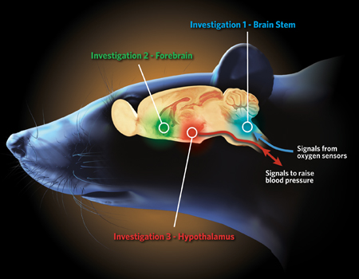
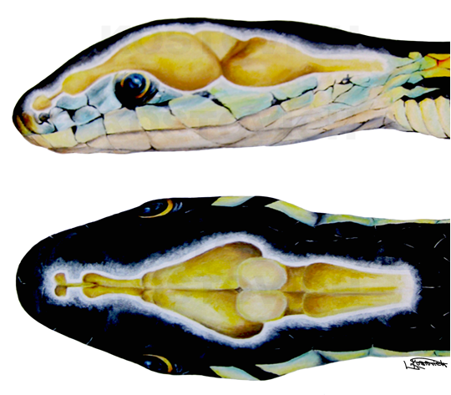
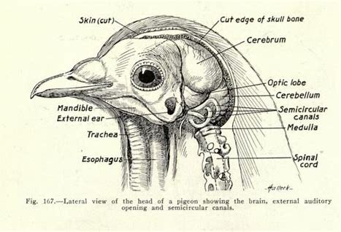
Neurons
How many neurons are there in the human brain?

Slide 3
Neurons
Is there such a thing as a typical neuron?

Slide 4
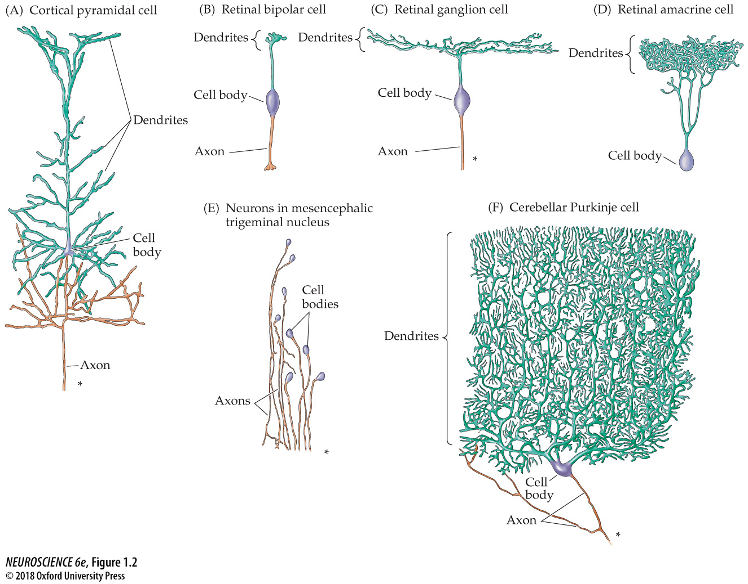
Notes:
FIGURE 1.2 Some of the diverse nerve cell morphologies in the human nervous system. These drawings are tracings of actual nerve cells stained by impregnation with silver salts (the so-called Golgi technique, used in the classic studies of Golgi and Cajal). Asterisks indicate that the axon runs on much farther than shown. Note, however, that some cells, such as the retinal bipolar cell, have very short axons, while others, such as the retinal amacrine cell, have no axon at all. The drawings are not all at the same scale.

Slide 5
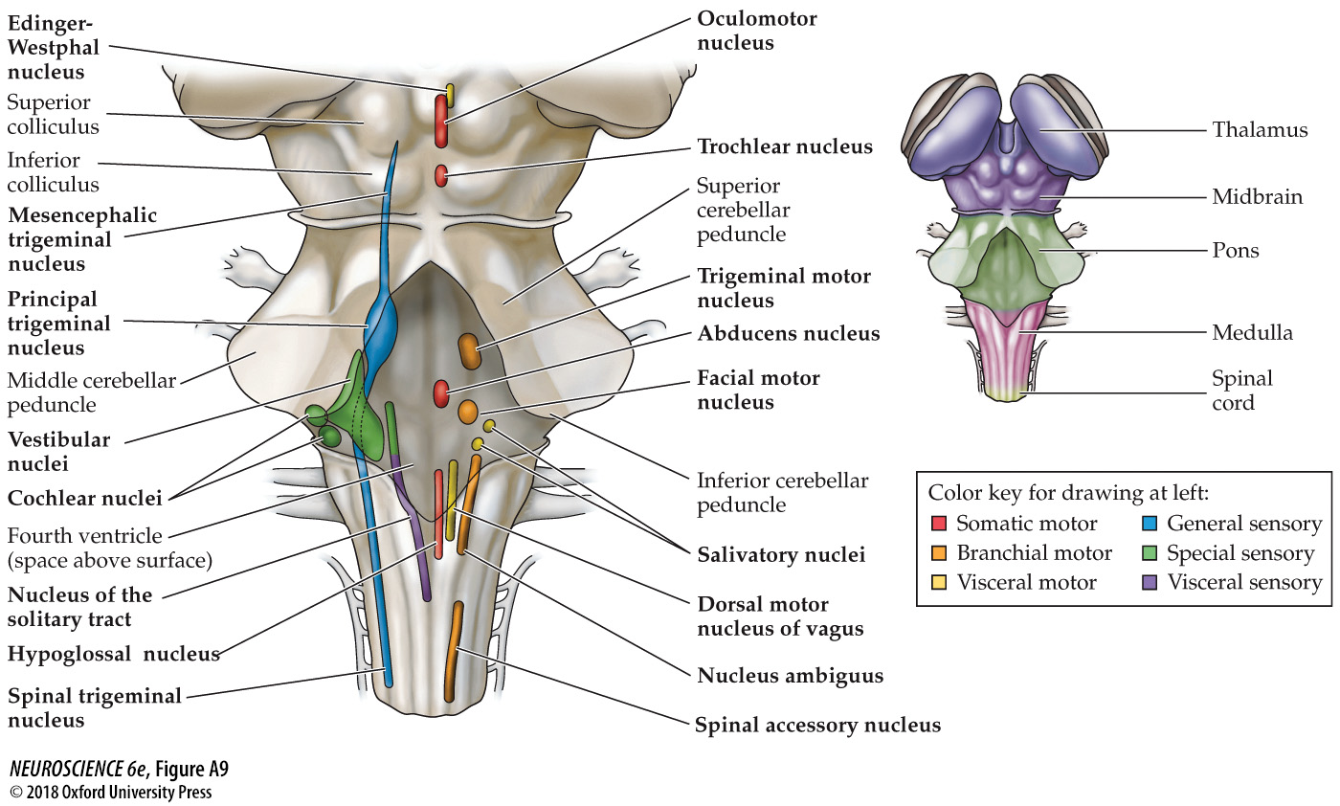
Cranial nerve nuclei of the brainstem
Notes:
FIGURE A9 Cranial nerve nuclei of the brainstem. This “phantom” view of the brainstem’s dorsal surface shows the locations of the brainstem nuclei that are either the target or the source of the cranial nerves. (See Table A2 for the relationship between each cranial nerve and cranial nerve nuclei, and Table A3 for a functional scheme that localizes cranial nerve nuclei with respect to brainstem subdivision and sensory or motor function.) With the exception of the nuclei associated with the trigeminal nerve, there is close correspondence between the location of the cranial nerve nuclei in the midbrain, pons, and medulla and the location of the associated cranial nerves. At right, the territories of the major brainstem subdivisions are indicated on the dorsal surface.

Slide 6
Notes:
FIGURE 1.2 Some of the diverse nerve cell morphologies in the human nervous system. These drawings are tracings of actual nerve cells stained by impregnation with silver salts (the so-called Golgi technique, used in the classic studies of Golgi and Cajal). Asterisks indicate that the axon runs on much farther than shown. Note, however, that some cells, such as the retinal bipolar cell, have very short axons, while others, such as the retinal amacrine cell, have no axon at all. The drawings are not all at the same scale.

Slide 7
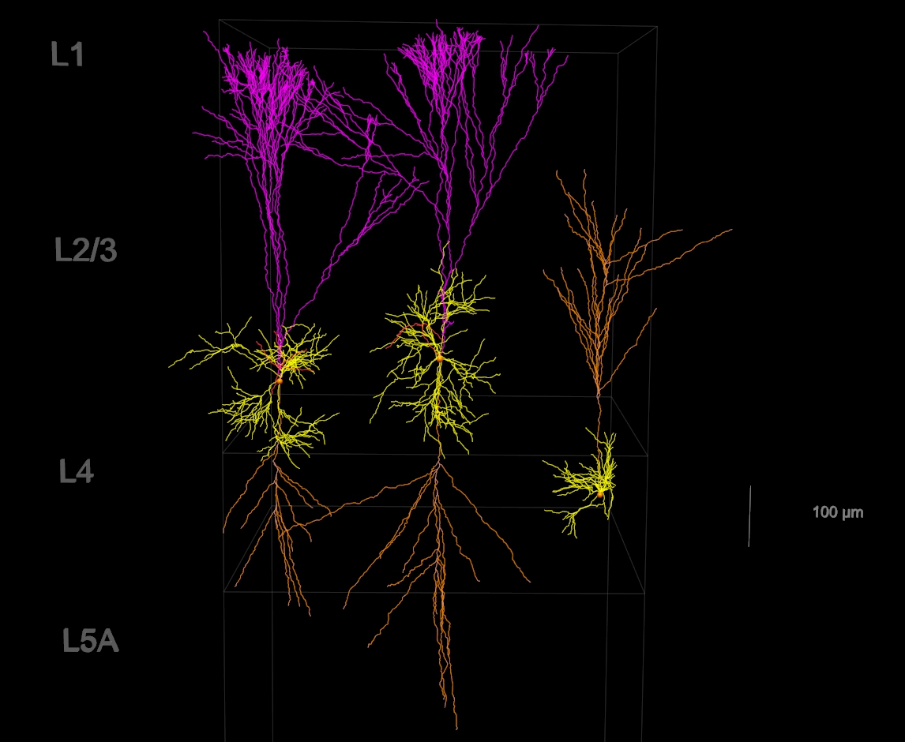

Slide 8
Notes:
FIGURE 1.2 Some of the diverse nerve cell morphologies in the human nervous system. These drawings are tracings of actual nerve cells stained by impregnation with silver salts (the so-called Golgi technique, used in the classic studies of Golgi and Cajal). Asterisks indicate that the axon runs on much farther than shown. Note, however, that some cells, such as the retinal bipolar cell, have very short axons, while others, such as the retinal amacrine cell, have no axon at all. The drawings are not all at the same scale.

Slide 9
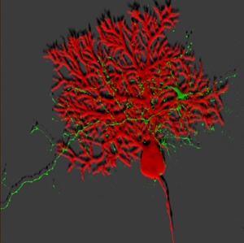
Confocal image of Purkinje cell (red) and an afferent (green): M. Hausser (University College London, UK)
Notes:
neuro3e-fig-01-02-3.jpg

Slide 10
Afferent
Efferent
Notes:
neuro3e-fig-01-02-3.jpg

Slide 11
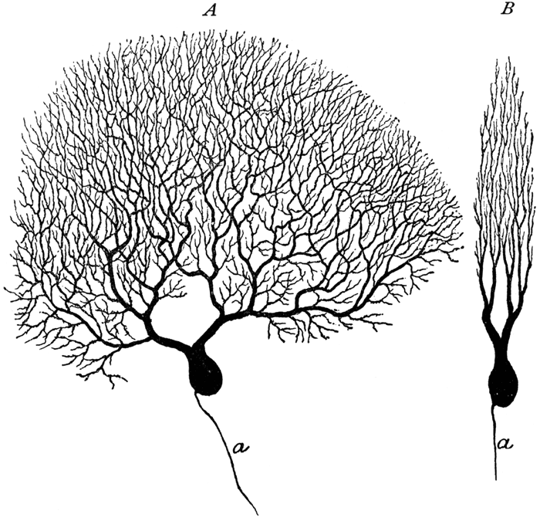

Slide 12
Notes:
FIGURE 1.2 Some of the diverse nerve cell morphologies in the human nervous system. These drawings are tracings of actual nerve cells stained by impregnation with silver salts (the so-called Golgi technique, used in the classic studies of Golgi and Cajal). Asterisks indicate that the axon runs on much farther than shown. Note, however, that some cells, such as the retinal bipolar cell, have very short axons, while others, such as the retinal amacrine cell, have no axon at all. The drawings are not all at the same scale.

Slide 13
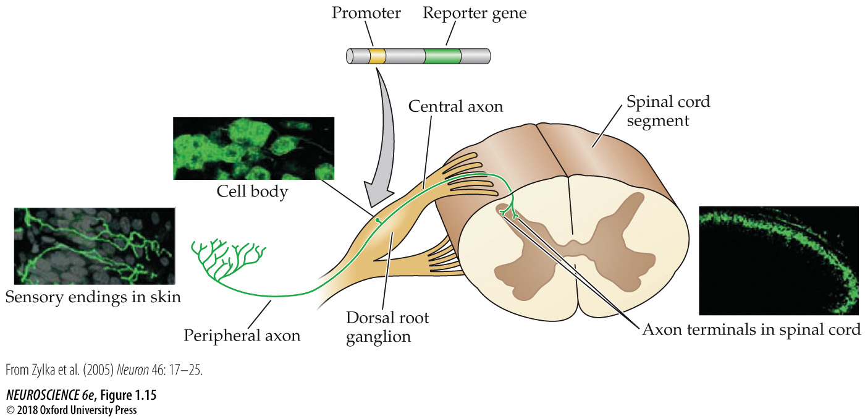

Slide 14
Notes:
FIGURE 1.2 Some of the diverse nerve cell morphologies in the human nervous system. These drawings are tracings of actual nerve cells stained by impregnation with silver salts (the so-called Golgi technique, used in the classic studies of Golgi and Cajal). Asterisks indicate that the axon runs on much farther than shown. Note, however, that some cells, such as the retinal bipolar cell, have very short axons, while others, such as the retinal amacrine cell, have no axon at all. The drawings are not all at the same scale.

Slide 15
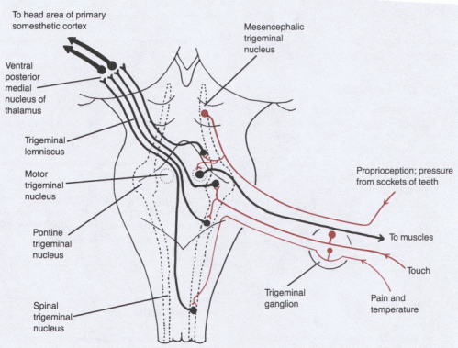
Cranial Nerve V (Trigeminal Nerve)

Slide 16
Notes:
FIGURE 1.2 Some of the diverse nerve cell morphologies in the human nervous system. These drawings are tracings of actual nerve cells stained by impregnation with silver salts (the so-called Golgi technique, used in the classic studies of Golgi and Cajal). Asterisks indicate that the axon runs on much farther than shown. Note, however, that some cells, such as the retinal bipolar cell, have very short axons, while others, such as the retinal amacrine cell, have no axon at all. The drawings are not all at the same scale.

Slide 17
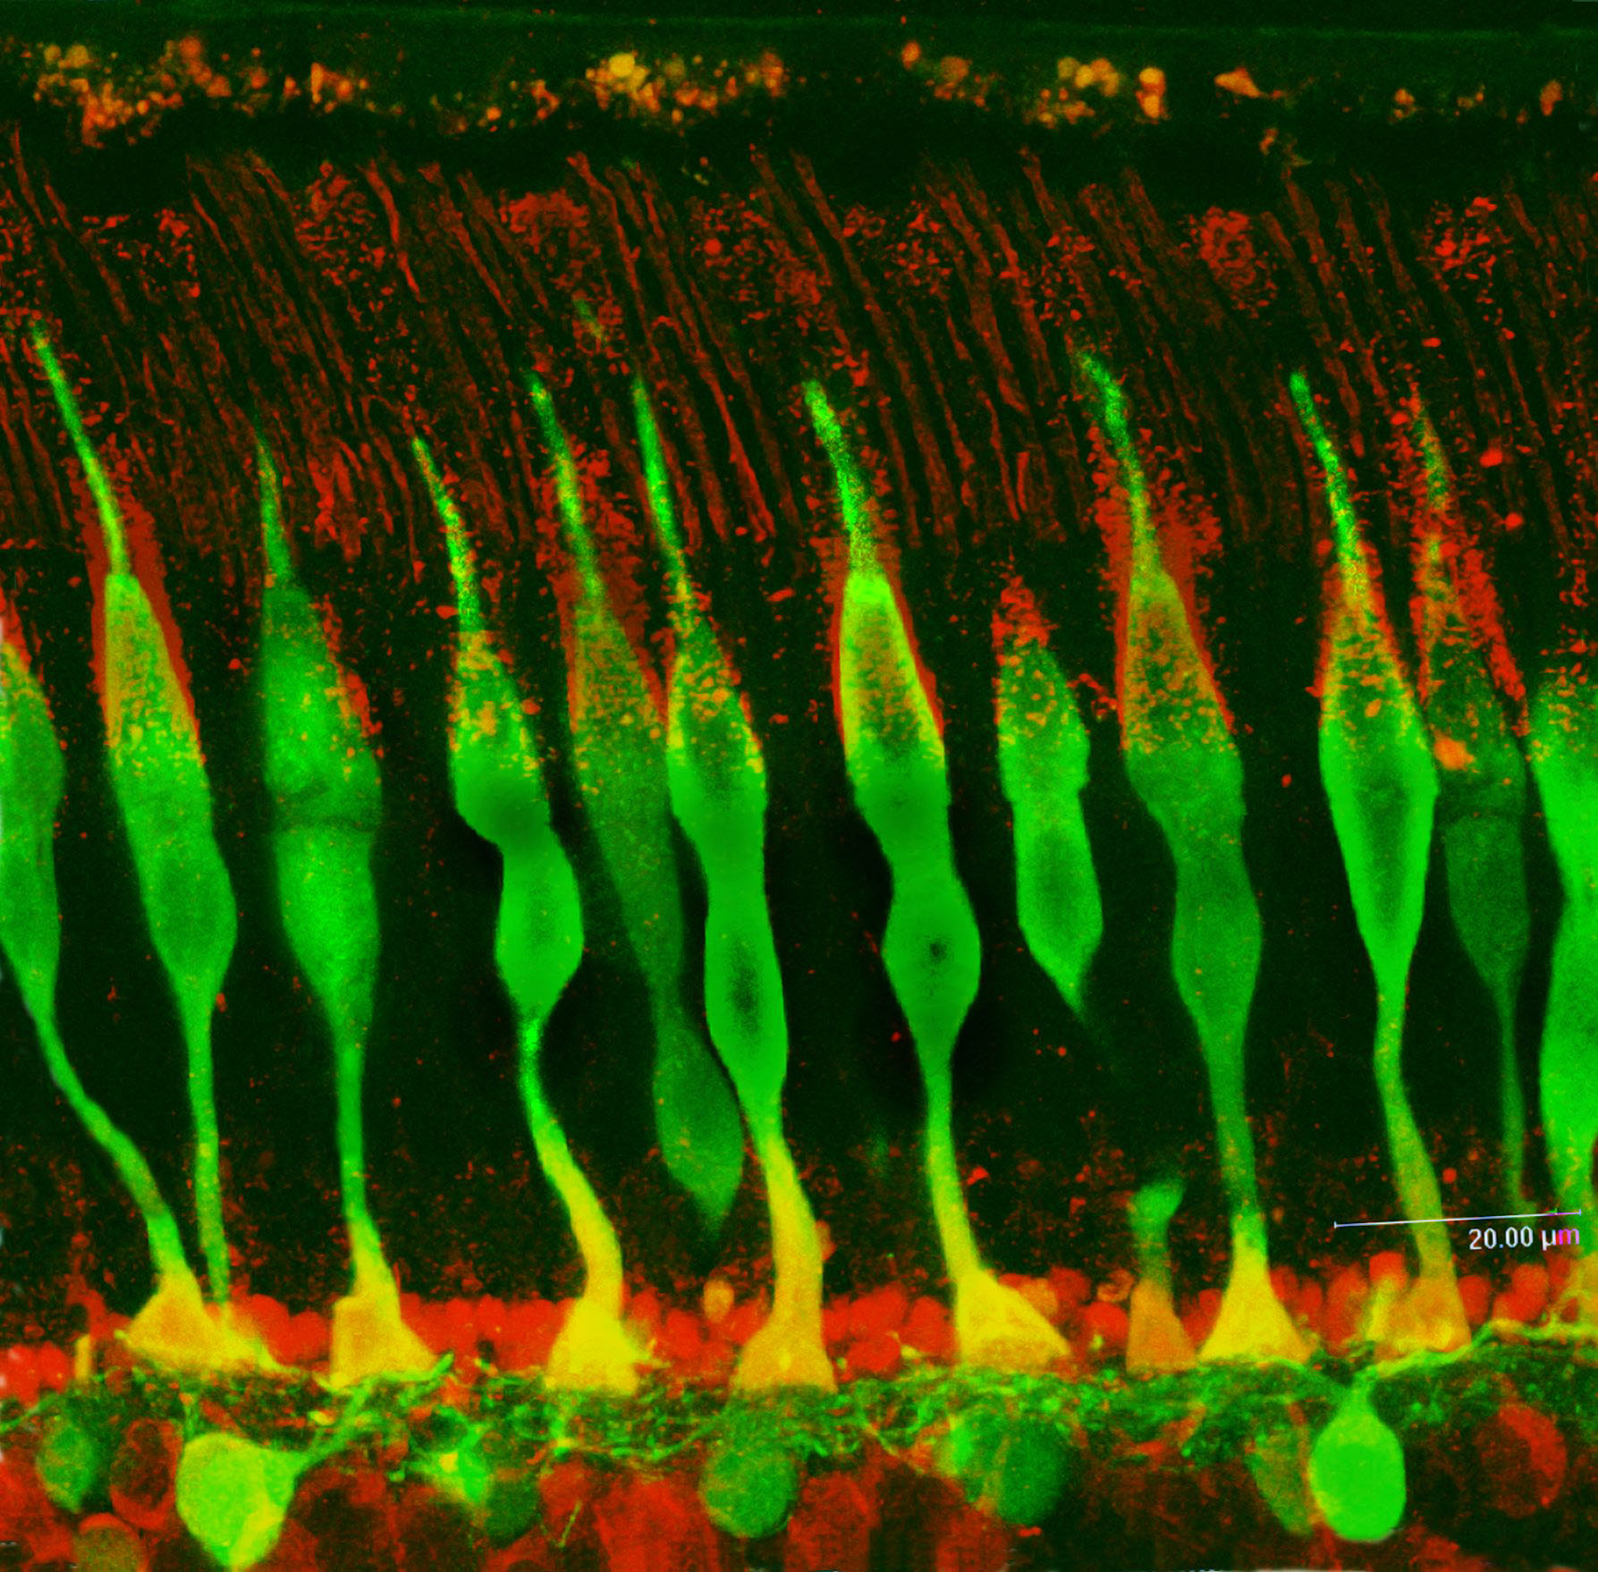
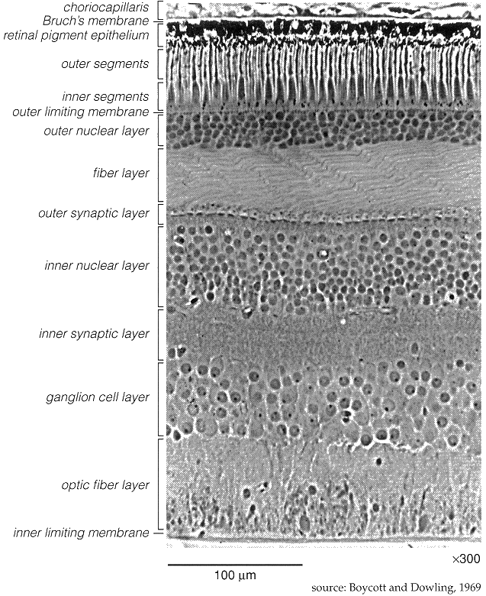

Slide 18
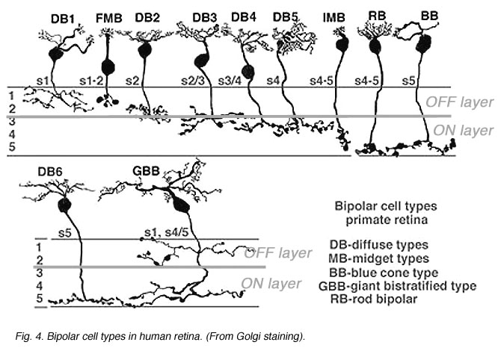
webvision.med.utah.edu
Notes:
neuro3e-fig-01-02-1.jpg

Slide 19
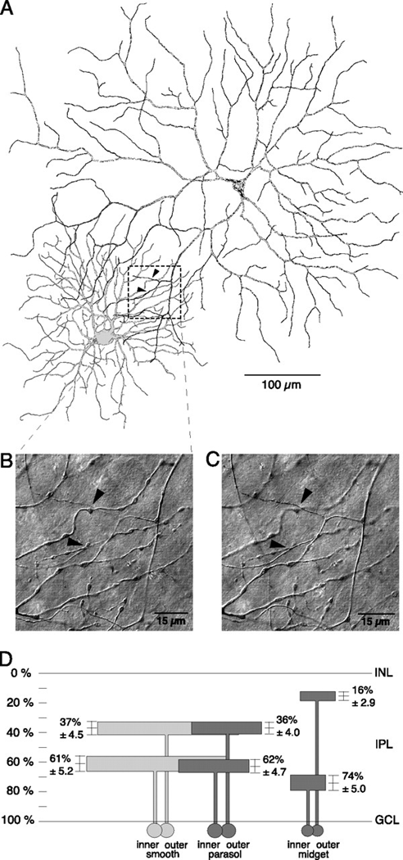
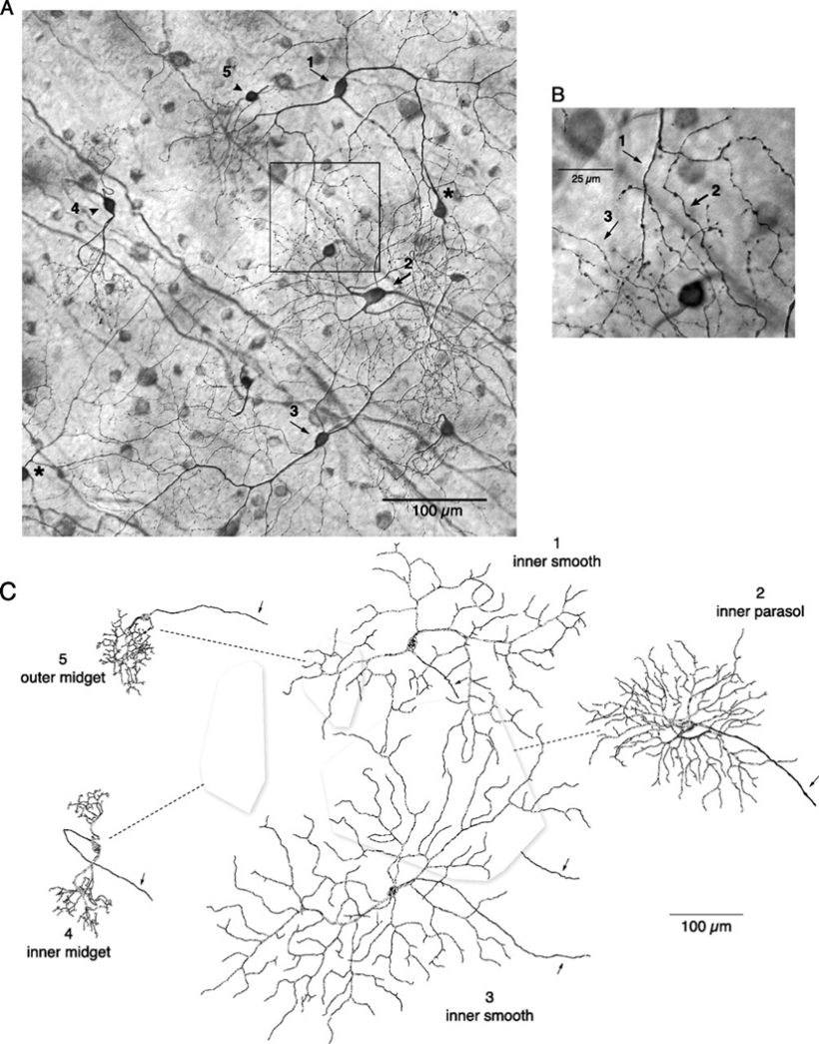

Slide 20
Notes:
FIGURE 1.2 Some of the diverse nerve cell morphologies in the human nervous system. These drawings are tracings of actual nerve cells stained by impregnation with silver salts (the so-called Golgi technique, used in the classic studies of Golgi and Cajal). Asterisks indicate that the axon runs on much farther than shown. Note, however, that some cells, such as the retinal bipolar cell, have very short axons, while others, such as the retinal amacrine cell, have no axon at all. The drawings are not all at the same scale.

Slide 21
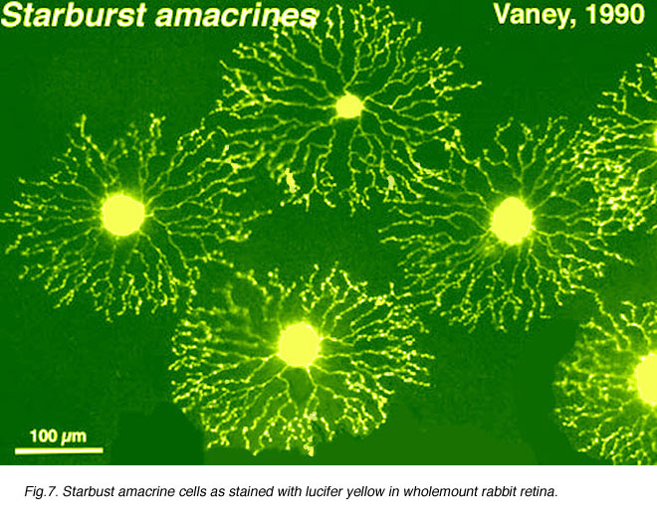
J\
ll

Slide 22
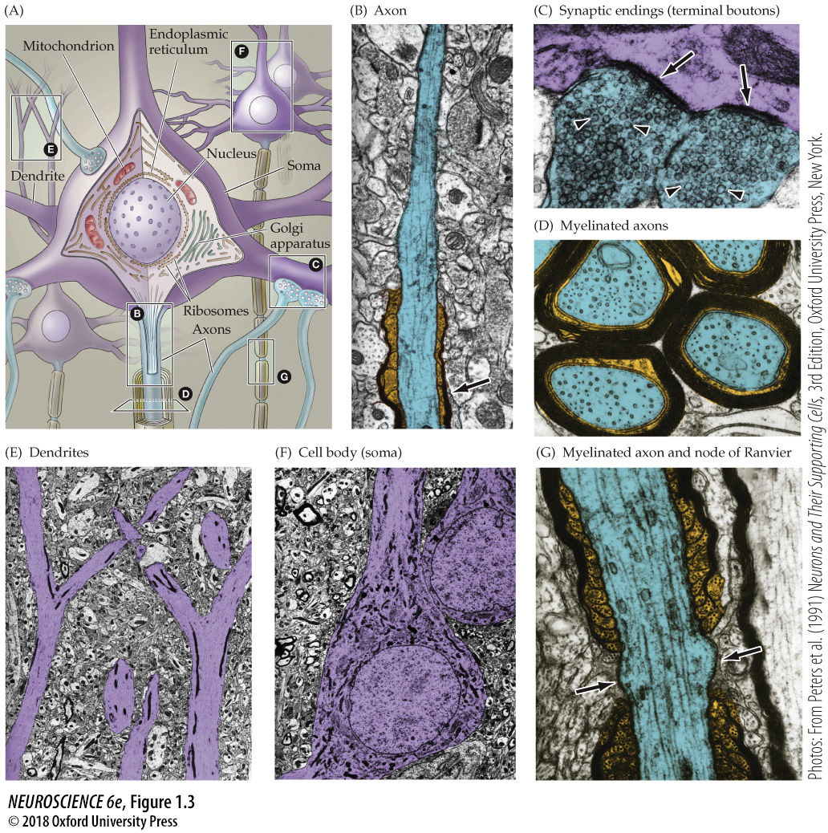

Slide 23
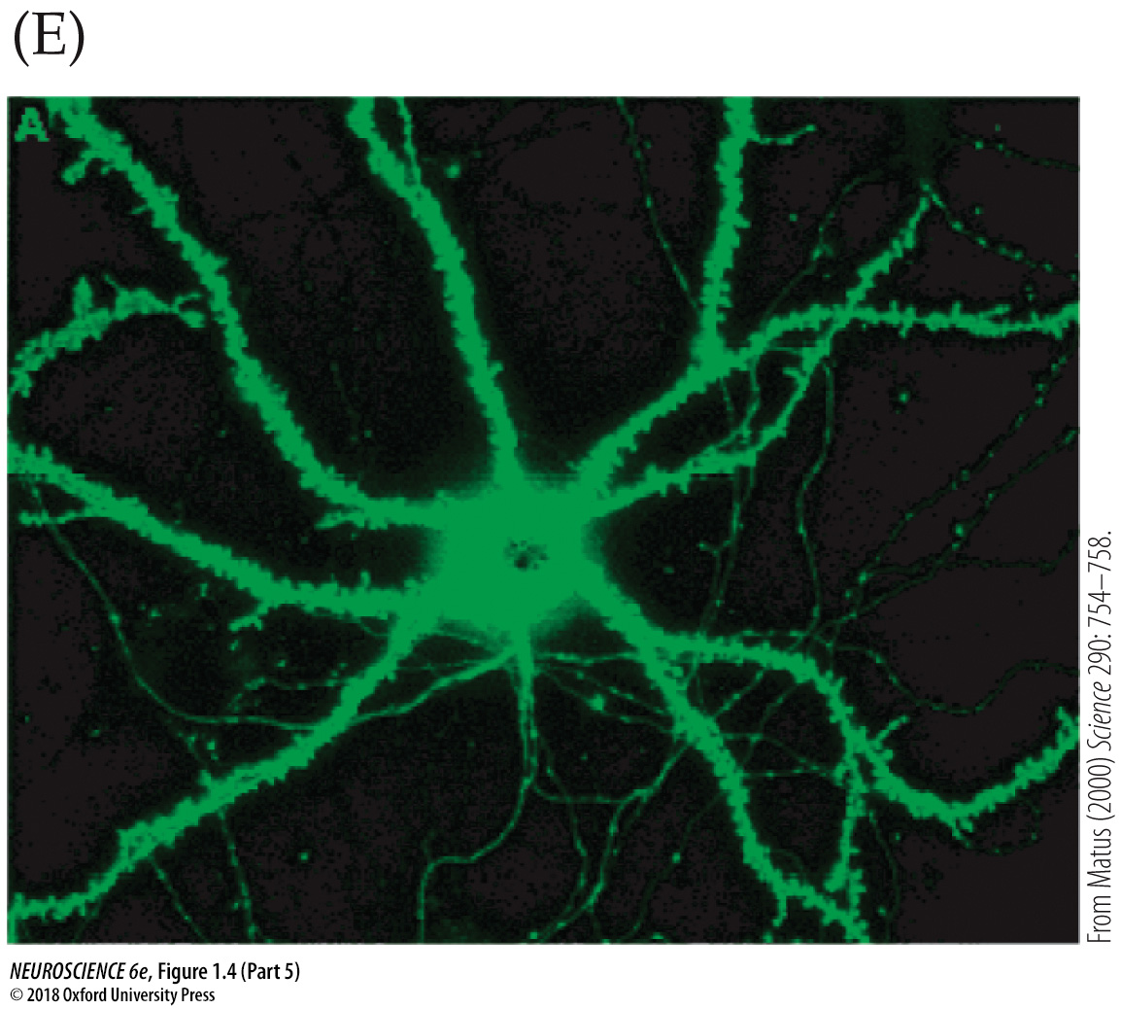
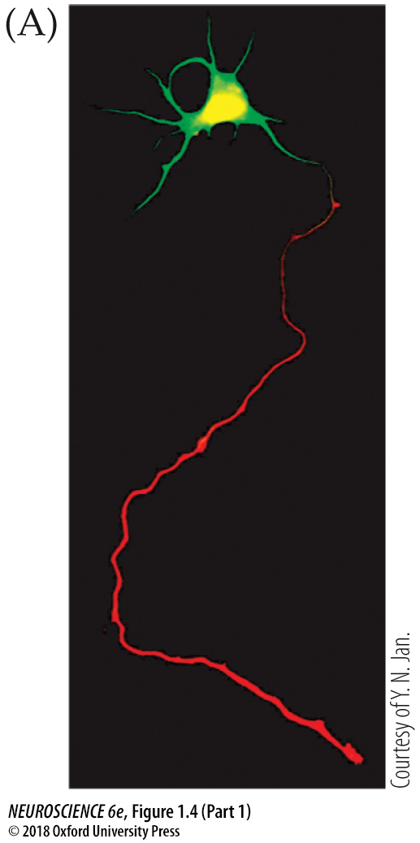
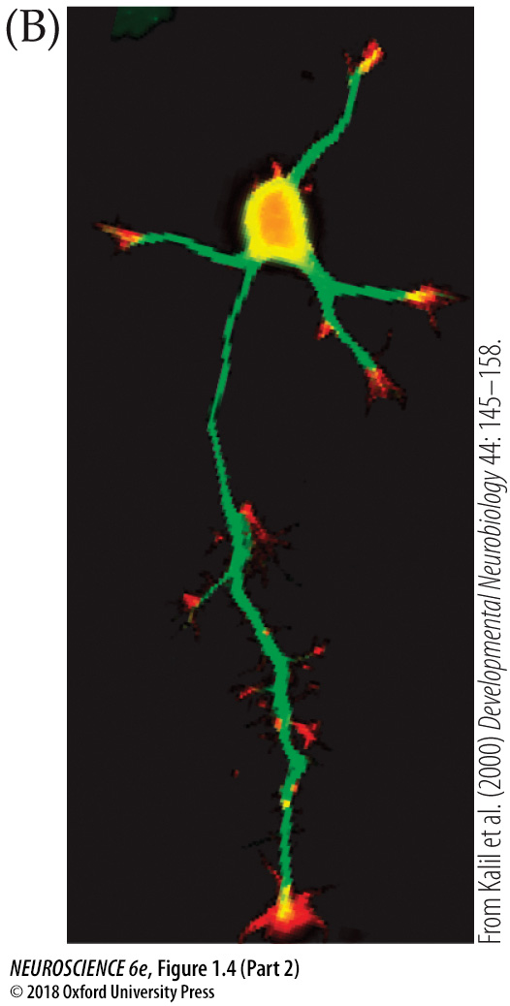
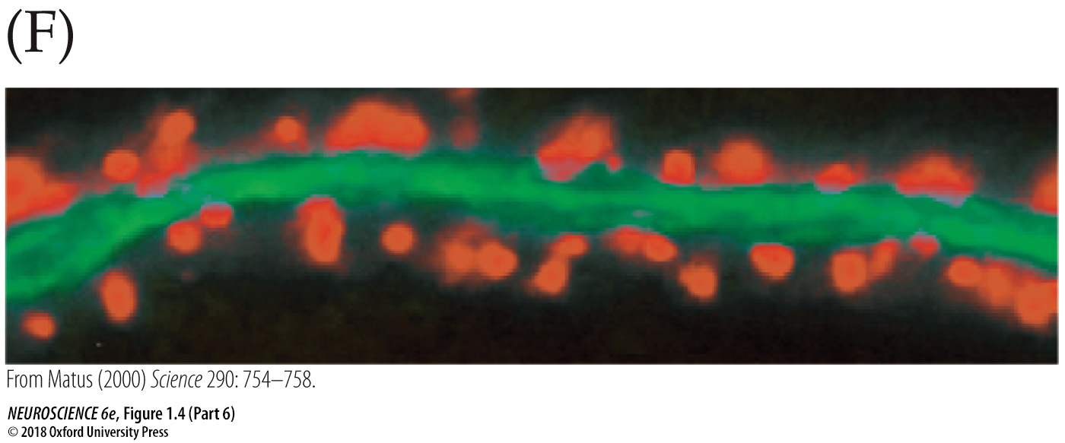

Slide 24
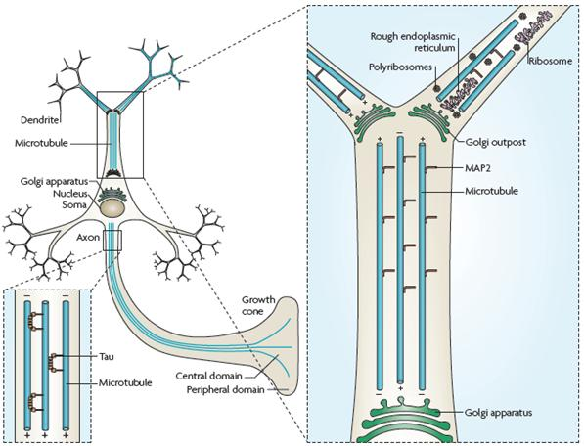
Golgi Complex

Slide 25
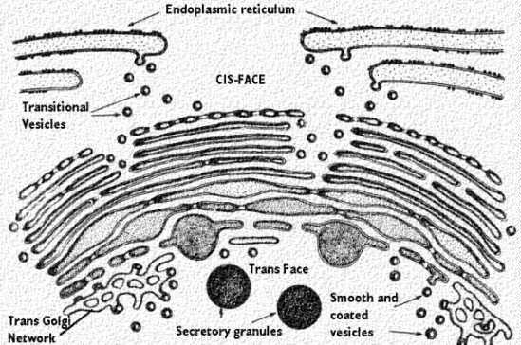
Golgi Complex

Slide 26
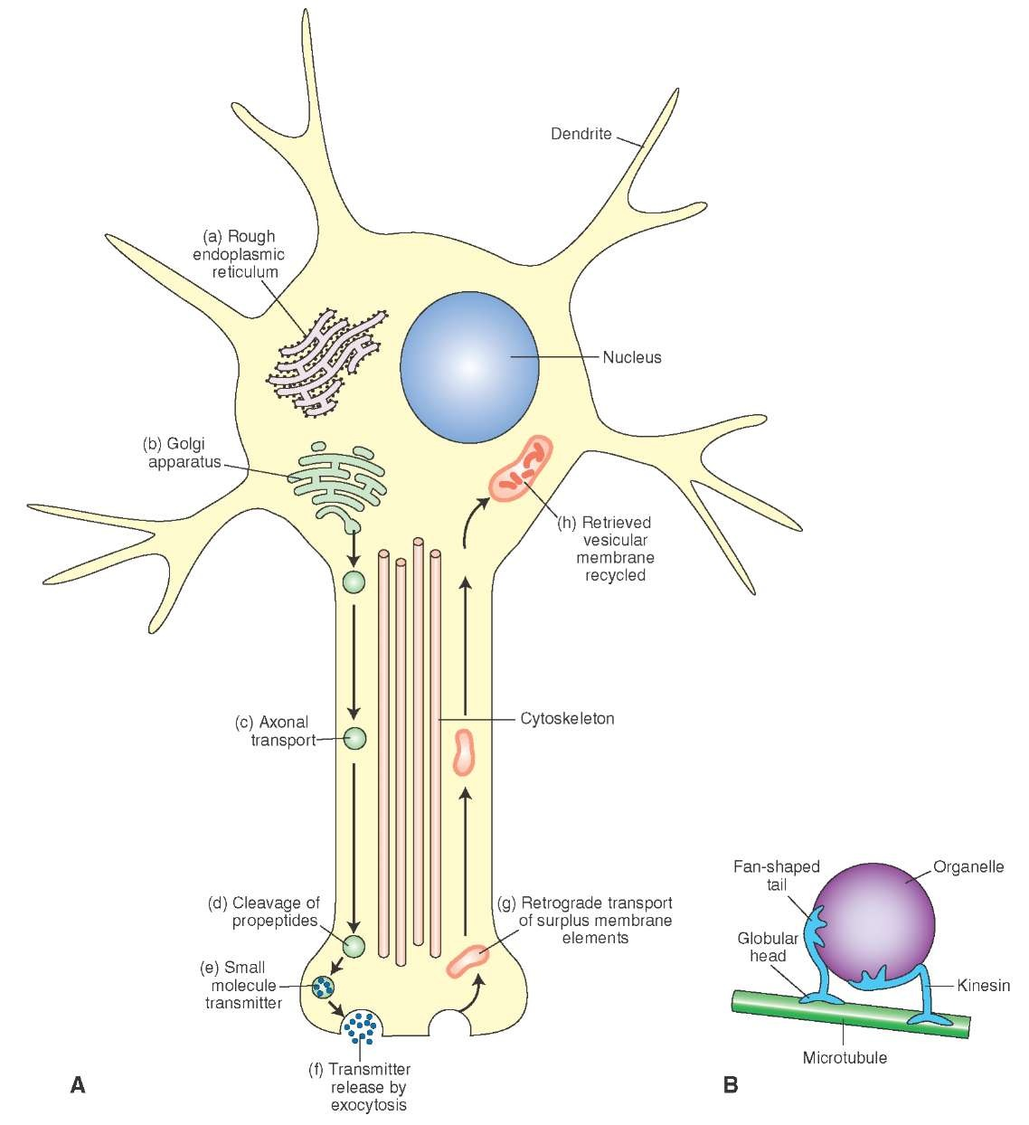
Axonal Transport

Slide 27
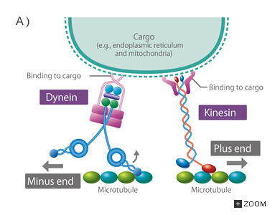
Axonal Transport

Slide 28
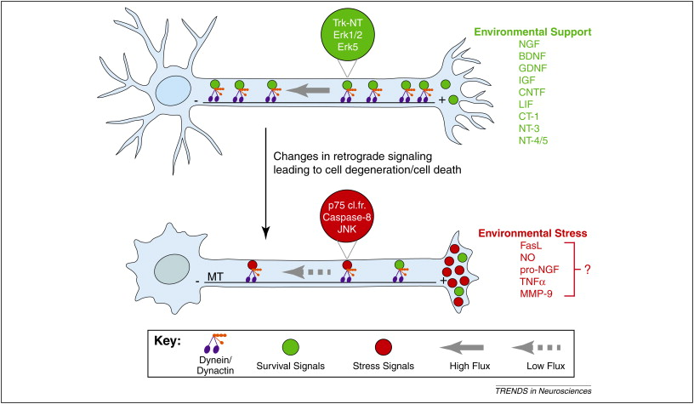
Neurotrophins

